Slide 1
Ambari
1.2
Using a Local Repository

Slide 2
Summary
Terminology
Repository: a repository that hosts software packages for download + install
Yum: a package manager that can fetch software packages from a repository
On RHEL/CentOS, typically “yum”.
On SLES, typically “zypper”
Local Repository: a repository that is hosted on a local network.
When working with machines that do not have Internet access, or have restricted (or limited) network access, you will need to setup a Local Repository in order to obtain the Ambari and HDP software packages.

Slide 3
Repositories
Ambari uses four Repositories…
Ambari
Hosts the Ambari Server, Ambari Agent and monitoring software packages
HDP
Hosts the Hadoop “Stack” packages (such as Hadoop, Pig, Hive, HCatalog, Oozie, HBase, ZooKeeper, Sqoop)
HDP-UTILS
Utility packages for Ambari and HDP, including Ganglia, Nagios, snappy and rrd
EPEL (Extra Packages for Enterprise Linux)
Set of additional packages for Enterprise Linux
Some components installed by Ambari (for example, Ganglia and Nagios) have dependencies that are available in EPEL
http://fedoraproject.org/wiki/EPEL

Slide 4
How Ambari Uses Repositories
Ambari Repo
HDP-UTILS Repo
HDP Repo
Ambari repo definition tells the Ambari server which Ambari and HDP-Utils repositories to use
1
1
1
HostA
HostB
HostC
Ambari Server
2
3
HostD
HostE
HostF
Ambari server tells all hosts in the cluster which Ambari and HDP-UTILS repositories to use
Ambari server tells all hosts in the cluster what HDP (“Stack”) repository to use
2
3

Slide 5
Configuring Repositories
By default, Ambari will use the publicly hosted software repositories
To use Local Repositories, you must…
First, setup the local repositories
Second, configure Ambari to use the local repositories
Note: We will not cover setting up a local EPEL repository. Many Data Centers already mirror or proxy the EPEL repository, so discuss with your Data Center team whether EPEL is already available from within your firewall.

Slide 6
First, Setup Local Repositories
Depending on your Internet access you have a few options
Highlighting the two most popular…
Option #1: Mirroring the packages to Local Repository
Use this option if you have Internet access available but not from the cluster hosts
Setup a host with Apache httpd
Copy the entire contents of each repository local using the “reposync” command
Run “createrepo” to build the repo metadata
Option #2: Download Repository Tarball and Build Local Repository
Use this option if you have no Internet access available
Setup a host with Apache httpd
Download a tarball copy of the each repositories entire contents
Extract contents
http://docs.hortonworks.com/HDPDocuments/HDP1/HDP-1.2.1/bk_reference/content/reference_chap4.html

Slide 7
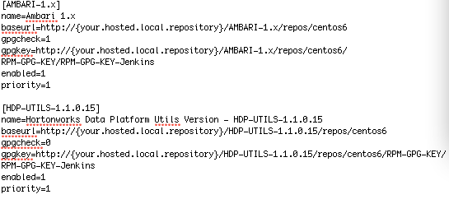
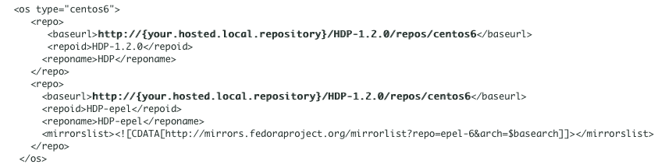
Second, Configure Ambari
Set ambari.repo to point to your Ambari and HDP-UTILS Local Repositories
Install Ambari Server
Configure the Ambari “Stacks” to point to your HDP Local Repository
http://docs.hortonworks.com/HDPDocuments/HDP1/HDP-1.2.1/bk_using_Ambari_book/content/ambari-chap1-6.html

Slide 8
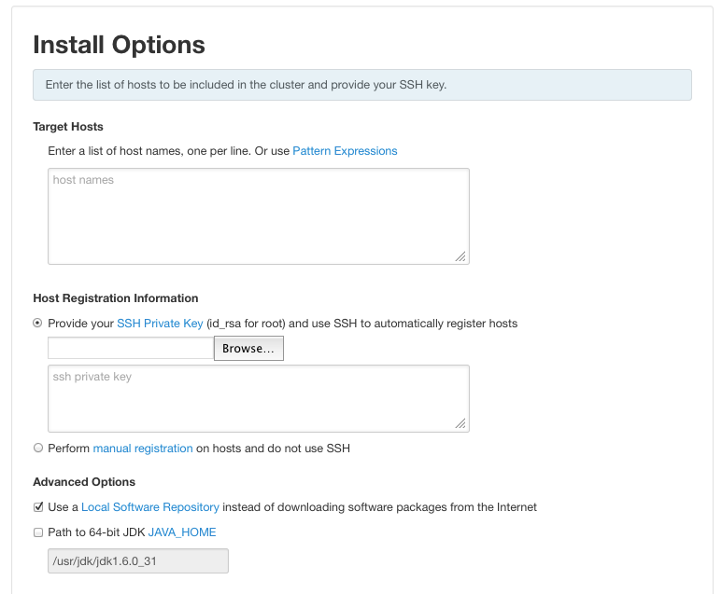
And Don’t Forget: Install Wizard Option
Need to check this box

Slide 9

A Word About the JDK…
Ambari (and Hadoop) need a JDK to run
Ambari automatically fetches the JDK from the Internet and installs
If you have limited Internet connectivity and need to use Local Repositories for software packages, you also need to setup for how to get the JDK w/o Internet access
Perform JDK install on each machine
And let Ambari know the location during install
Alternatively, download JDK & put in place on Ambari Server before cluster install
Ambari Server will distribute JDK to cluster hosts

Slide 10
Useful Resources
Resource | Link
Deploying HDP in Data Centers with Firewalls | http://docs.hortonworks.com/HDPDocuments/HDP1/HDP-1.2.1/bk_reference/content/reference_chap4.html
Configure Ambari to Use Local Repositories | http://docs.hortonworks.com/HDPDocuments/HDP1/HDP-1.2.1/bk_using_Ambari_book/content/ambari-chap1-6.html
Apache Ambari Project Page | http://incubator.apache.org/ambari/
Apache Ambari User Group | http://www.meetup.com/Apache-Ambari-User-Group/
Apache Ambari JIRA | https://issues.apache.org/jira/browse/AMBARI

